Slide 1
SIMPLE LINEAR REGRESSION
ttnghia@tma.com.vn
Notes:
Regression: a measure of the relation between the mean value of one variable (e.g., output) and corresponding values of other variables (e.g., time and cost). Refer to https://onlinecourses.science.psu.edu/stat501/node/250a

Slide 2
What is Simple line Regression ?

Slide 3
Overview
Simple linear regression is a statistical method that allows us to summarize and study relationships between two continuous (quantitative) variables:
One variable, denoted x, is regarded as the predictor, explanatory, or independent variable.
The other variable, denoted y, is regarded as the response, outcome, or dependent variable.

Slide 4
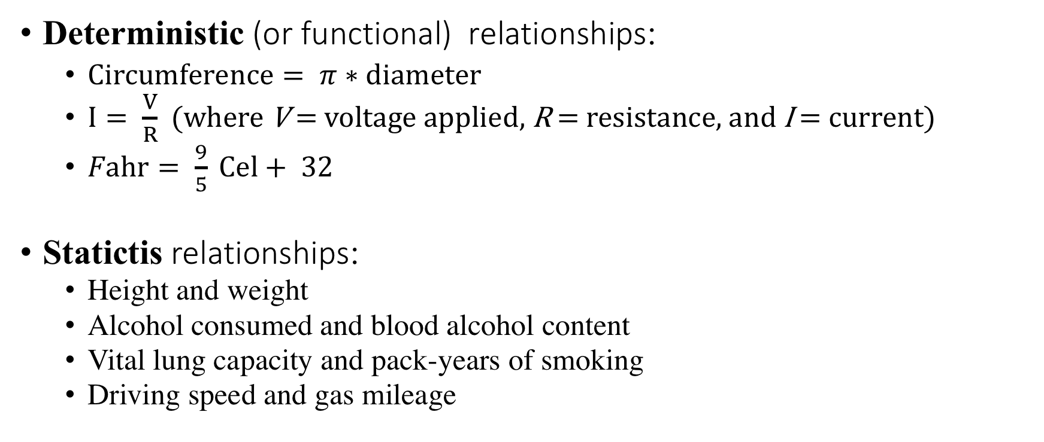
Types of relationships
Deterministic (or functional) relationships:
$Circumference= π∗diameter$
$I= \frac{V}{R}$ (where V = voltage applied, R = resistance, and I = current)
$Fahr= \frac{9}{5} Cel+ 32$
Statictis relationships:
Height and weight
Alcohol consumed and blood alcohol content
Vital lung capacity and pack-years of smoking
Driving speed and gas mileage

Slide 5
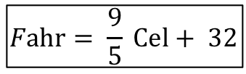
Deteministic relationship
$$Fahr= \frac{9}{5} Cel+ 32$$
Fahrenheit
Celsius
Notes:
That is, if you know the temperature in degrees Celsius, you can use this equation to determine the temperature in degrees Fahrenheit exactly.

Slide 6
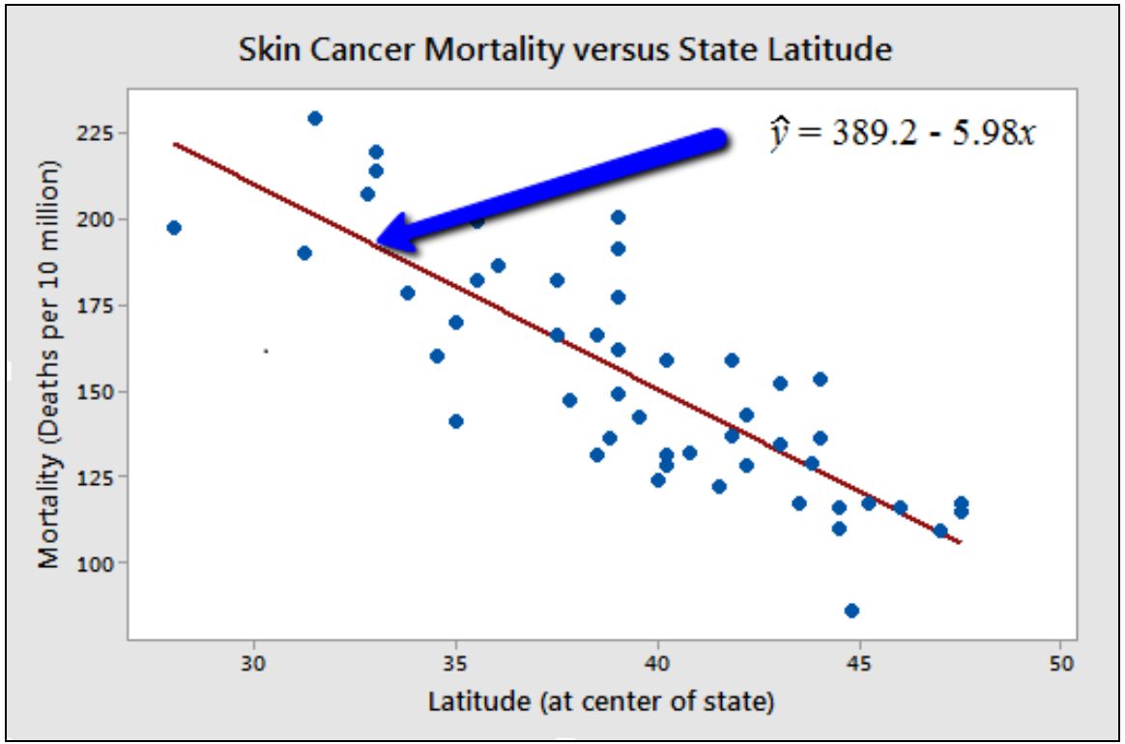
Statistic relationship
Notes:
You might anticipate that if you lived in the higher latitudes of the northern U.S., the less exposed you'd be to the harmful rays of the sun, and therefore, the less risk you'd have of death due to skin cancer. The scatter plot supports such a hypothesis. There appears to be a negative linear relationship between latitude and mortality due to skin cancer, but the relationship is not perfect. Indeed, the plot exhibits some "trend," but it also exhibits some "scatter." Therefore, it is a statistical relationship, not a deterministic one.

Slide 7
What is the “Best Fitting Line” ?

Slide 8

Best fitting line
The equation for the best fitting line is:
$$y^{^}=b_{0}+b_{1}x$$

Slide 9

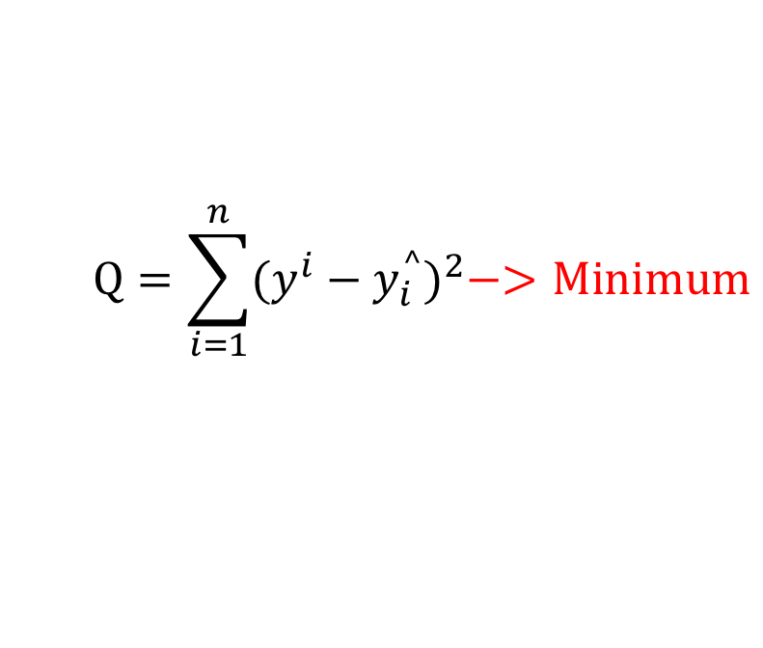
Least squares method
The equation of the best fitting line is: $y_{i}^{^}=b_{0}+b_{1}x_{i}$
We just need to find the values b₀ and b₁ that make the sum of the squared prediction errors the smallest it can be.
That is, we need to find the values b₀ and b₁ that minimize:
$$Q=\sum_{i=1}^{n}{{(y^{i}−y_{i}^{^})}^{2}−>Minimum}$$

Slide 10
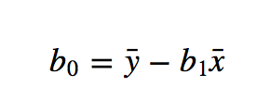
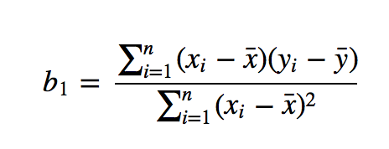
Least squares method
: mean of all of the x-values
: mean of all of the y-values

Slide 11
Demo with Python and R

Slide 12
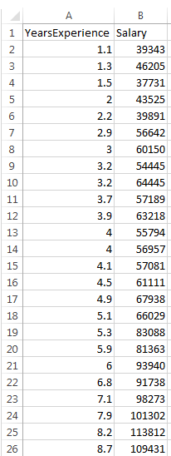
Dataset Business Problem
Independent variable
Dependent variable

Slide 13


Simple Linear Regression
Salary
$$y = b_{0} + b_{1}∗x$$
$$Salary= b_{0}+ b_{1}∗Experience$$
Experience

Slide 14



Simple Linear Regression
$$y_{i}$$
Salary
$$y_{i}^{^}$$
$$SUM{\left(y − y^{^}\right)}^{2} →min$$
Experience
Least squares method

